Slide 1
How To Read a
Research Paper

Slide 2
Two Types of Scientific Papers Containing Two Types of Information
There are two types of scientific papers:
Review articles: give an overview of the scientific field or topic by summarizing the data and conclusions from many studies.
Primary research articles: contain the original data and conclusions of the researchers who were involved in the experiments and how the experiments were done.

Slide 3

Few easy ways to distinguish between Review & Primary research
Many reviews will be labeled as "review“ on the first page of the article.
Reviews don't have a "methods" section.
In a review article, graphs, tables,
or figures containing actual data will
contain citations in the figure legend
to the primary research papers that
originally reported the findings.

Slide 4
Research Papers
Primary form in which research results are disseminated in computer science
Conference papers (shorter)
Journal papers (longer)
  Often the complete version of a conference paper
  May come out several years after the conference paper

Slide 5
Why bother ourselves?
Journal papers are current
  Textbooks are often years out of date.
  Journals are generally the most accessible means of obtaining the information that you need.
You can get a good explanation for your data and enough details to replicate what you read about.
To find out exactly what the latest developments are in a field.
To find out how a certain piece of research was done.
Because one day soon you could be writing papers too!

Slide 6
Reading a Paper Critically
Understand the problem
Understand the proposed solution
Understand competing approaches / designs
Evaluate the paper
Peer review is the cornerstone of the scientific publishing process

Slide 7
Why?
Learn to do research
Learn to think critically about quality of research papers
  Someone will be thinking critically about your own work!
  In any discipline, there are fads and there are lasting ideas… learn to tell the difference!
Gain perspective
Key issue: what are the questions to ask?

Slide 8
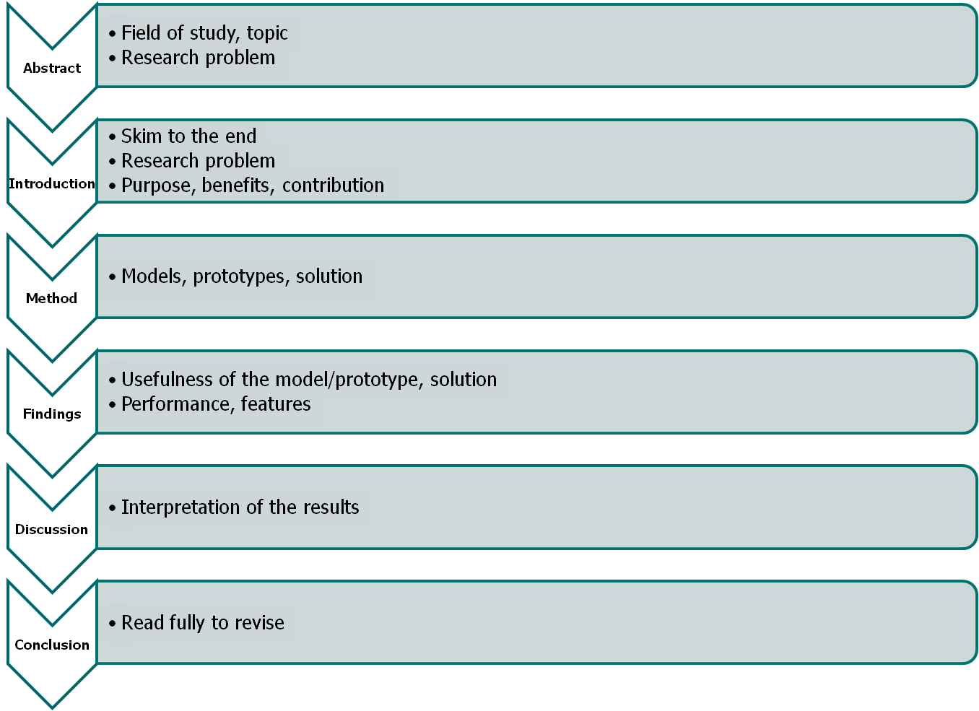
Anatomy of a Research Article
slide <number>

Slide 9
Evaluating a Paper
What is the problem being solved?
  Is it important? Relevant? Why?
  What is the prior work in this area?
Is the proposed solution clever?
  Cleverness is orthogonal to importance!
Are the assumptions and model reasonable?
Impact
  Easier to evaluate for older papers
  Does other work build on it? Do other papers use techniques and solutions proposed in this paper?

Slide 10
Evaluation Process
Read slowly, take notes as you read
  Question assumptions, importance of the problem
  Write questions to track what you don’t understand
Sometimes what is not in the paper is more important than what is in it
  Is there something the authors have overlooked?
Don’t let ideas or design details pass until you understand them!
Do not assume the paper is correct, even if published in a prestigious peer-reviewed venue

Slide 11
Ground Rules
Try to understand
Don’t be afraid to ask
Be constructive
Be polite
Don’t be afraid to criticize (constructively!)

